Slide 1

Section 11.7 Strategy for Testing Series
Lecture 1
Organizing Results

Slide 2

Section Homework Submission to Canvas
Preview of section​
Skim section, write short paragraph summary, list all important definitions / theorems / formulas.​
Notes on video lectures​
Include all details, worked examples, your own thoughts​
Worked examples from text​
Solutions to exercises​
Final reflection of section​
List of key takeaways to remember​

Slide 3

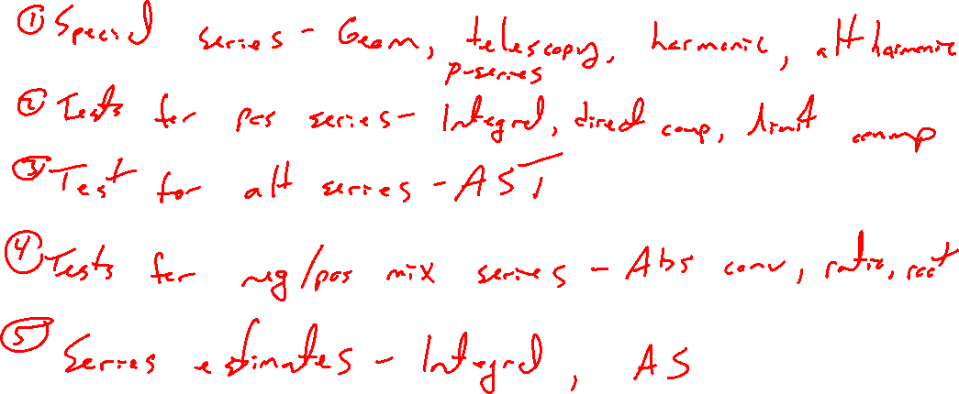
Summary of Results So Far
Notes:
Special series: geom, teles, harmonic, p
Tests for series with pos terms: div, integral direct comparison / limit comparison
Test for series with alternating sign: alt ser test
Tests for series with pos and neg terms (but not alternating)
Estimates: integral, alt ser test

Slide 4
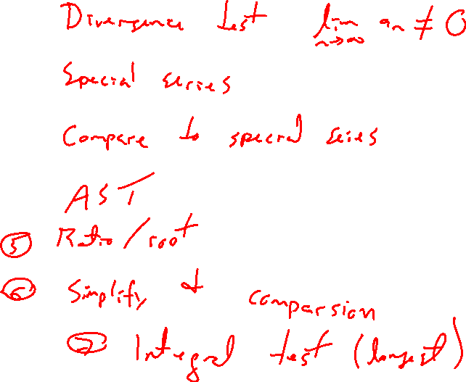
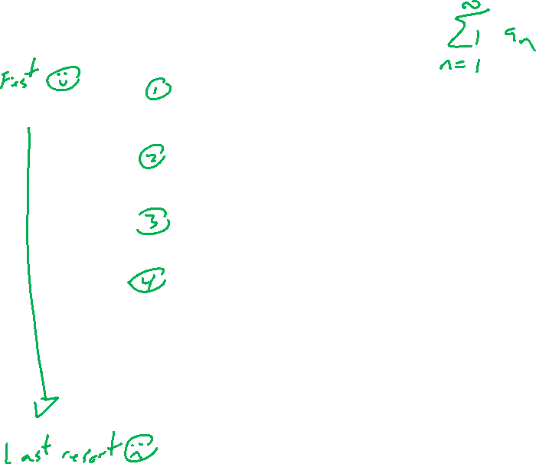
Order of Tests to Try
Notes:
Divergence test
Special series
Compare to special series
AST
Root / ratio
Compare to make simpler
Integral test (last resort)

Slide 5

Section 11.7 Examples and Homework
Rework textbook examples: 1, 2, 3, 4, 5, 6
Write down problem.
Close book and attempt on own.
Compare your solution to text solution, improve your writing.
GIVE SOLUTIONS, NOT JUST TEST
Exercises: NONE!

Slide 6

Section Homework Submission to Canvas
Preview of section​
Skim section, write short paragraph summary, list all important definitions / theorems / formulas.​
Notes on video lectures​
Include all details, worked examples, your own thoughts​
Worked examples from text​
Solutions to exercises​
Final reflection of section​
List of key takeaways to remember​

